Slide 1



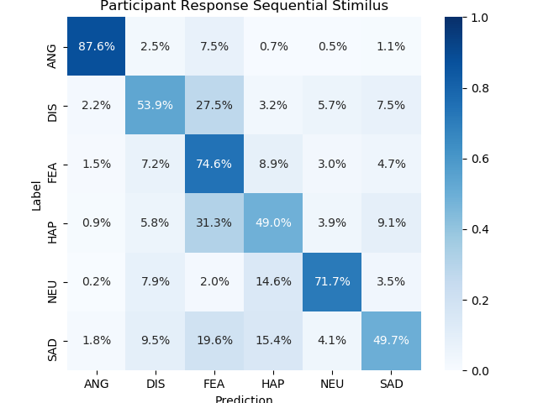
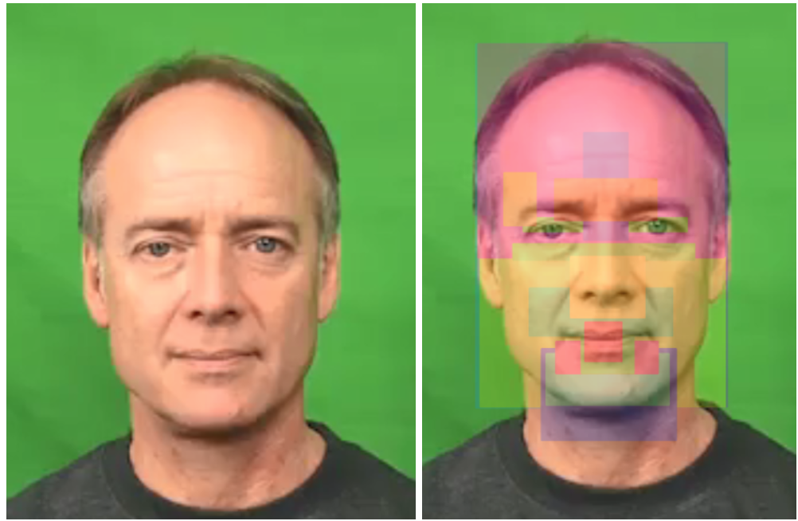


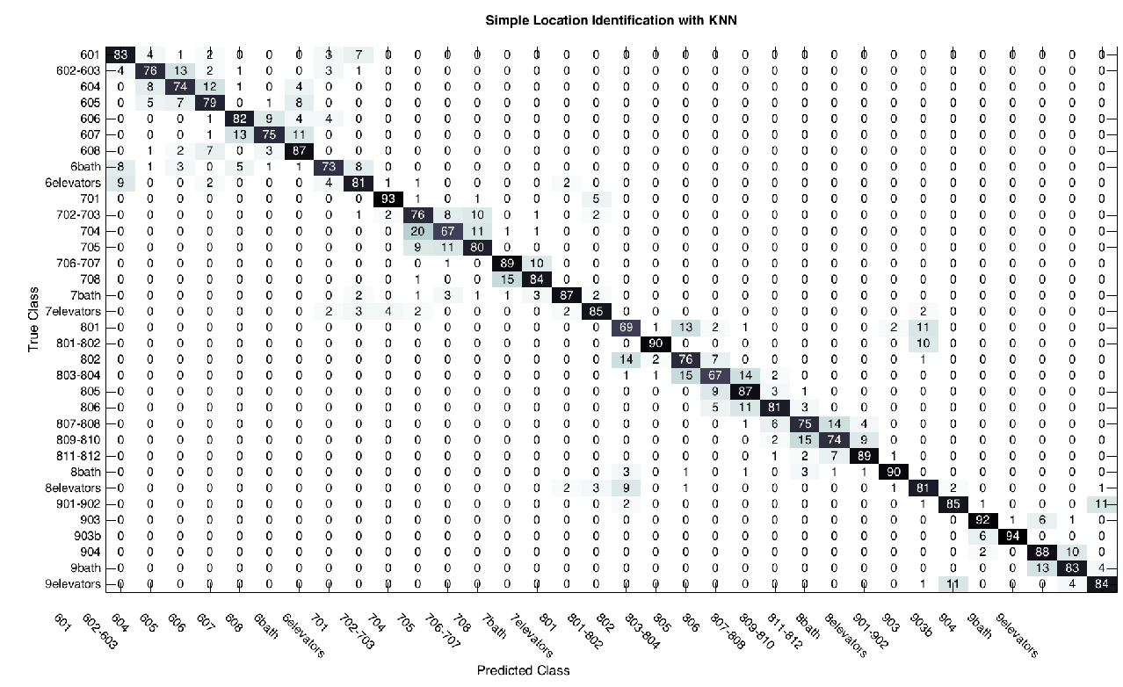


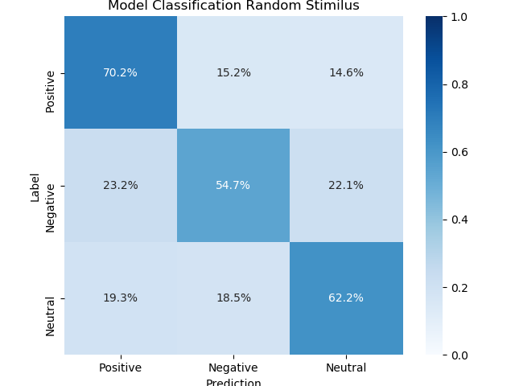
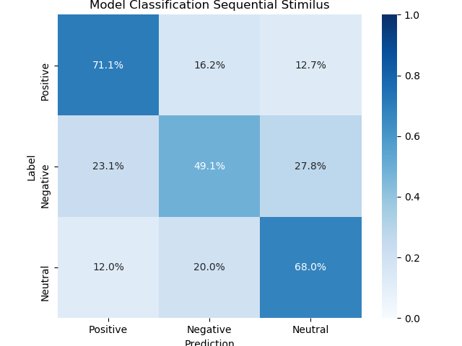
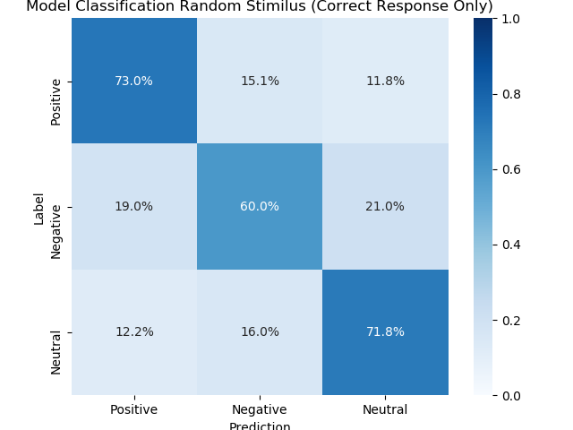
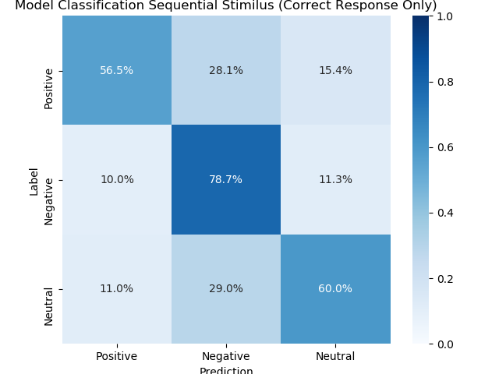
Analysis of Eye Fixations During Emotion Recognition in Faces
REU fellows: Forest Elliott¹
Faculty Mentors: Dr. H. Cao²
Affiliation: ^{1.}Oberlin College, ^{2.} School of Engineering and Computing Science, NYIT
Emails: forest.elliott@oberlin.edu, hcao02@nyit.edu
ABSTRACT
PARTICIPANT RESULTS
DISCUSSIONS
Automatic emotion recognition is a challenging task as emotions can be expressed in a variety of different ways. Most recognition studies have created audio-visual models for classifying emotions. In this study, a new model is proposed based off of human emotion perception. Participants were asked to identify emotions expressed in videos from the CREMA-D database while there gaze patterns were tracked by the Tobii X3-120. The participants watched to sessions of videos, one session having videos in random order and the other having the actors appear in sequential order. The participants gaze patterns were analyzed by looking at their fixation times on specific facial features of the actor in the videos. A decision tree was then used to select the most important facial features needed for a person to recognize negative, positive and neutral emotions. The data mining tool WEKA is used to generate this tree by implementing the J-48 algorithm for generating classifiers. Using this method, classification rates of 63.9%, 64.8%, 66.6% and 69.6% were obtained for sequential, random, correctly perceived sequential, and correctly perceived random respectively.
Fig. 1: Confusion Matrices of Participants
Fig. 2: Areas of Interest on Video Stimulus
Table I:
Average Perception Rate of Participants for Random and Sequential Sessions
Decision Tree vs. Participant
With sequential video stimulus Participants have higher classification rate than decision tree
With random video stimulus Participants have lower classification rate than decision tree
Stimulus Order | Average Perception Rate
Random | 58.1%
Sequential | 70.1%
Random vs. Sequential
With both entire data set and only correctly perceived data set, random stimulus had a higher classification rate than sequential stimulus
Entire data set vs. Perceived data set
With both random and sequential stimulus, perceived data set had higher classification rates than entire dataset
BACKGROUND & MOTIVATION
Table II:
Results of Statistical Tests: AOI with Statistically Different Means Fixation Time for Emotions (Negative, Positive, Neutral)
Automatic Emotion Recognition
The ability for computer to automatically recognize human emotion
Tackled through a variety of audio/visual channels
Applications in Education, HCI, RHI and Medicine
Stimulus Order | AU with Significantly Different Mean Fixation Time
Random | AU1, AU4, AU6, AU7, AU9, AU12, Left face, Lower face, Right face, and Upper face
Sequential | AU7, AU9, Left face, Right face, and Upper face
CONCLUSION
[1]
Human emotions are subtle and can be expressed through a variety of different audio visual channels. In this study we focused on the human perception of facial expressions and movements as a channel to classify emotions. We studied eye fixation while participants watched a series of video stimulus of actors expressing emotions. Using a decision tree and statistical tests, the analysis showed that fixation on facial movements was an effective channel for automatic emotion recognition. We discovered that with random video stimulus, the eye fixation on AOI has better machine learning results and there are more AOI with significantly different means than sequential stimulus. Also when using only participants correctly perceived data, the machine learning models have better results and less confusion between the emotions.
[2]
Action Units (AU)
Encode Facial Movements
Combine them to represent emotions
[3]
MACHINE LEARNING & RESULTS
Decision Trees Used for Machine Learning
Data Pruning and Attribute Selection
J-48 Algorithm in WEKA
Divided data into entire data set and only correctly perceived data
10-fold cross validation for evaluating model
SMOTE (Synthetic Minority Over-sampling Technique)
Imbalance of data classes (Negative, Positive, Neutral)
SMOTE makes new synthetic points to balance classes for machine learning
[4]
PROBLEM & OBJECTIVE
Research problem:
Do humans focus on specific facial movements and inflections when perceiving emotions?
Can this data be used to create an accurate model to predict emotions being perceived?
FUTURE WORK
Full Data Set:
Correctly Perceived Data Set:
Study difference in eye fixation and gaze data between audio and muted video stimulus
Collect more data and explore deep learning options
Develop new models based off of different eye gaze data besides fixation time in AOI such as gaze sequence.
Objective:
To determine if humans perceive emotions by focusing on specific AU, and build a model that predicts the stimulus emotion based off these fixations
Table III:
Classification Rate of Decision Tree on Entire Data Set
Table V:
Classification Rate of Decision Tree on Correctly Perceived Data Set
Stimulus Order | Classification Rate of Decision Tree
Random (All data) | 64.8%
Sequential (All data) | 63.9%
Stimulus Order | Classification Rate of Decision Tree
Random (Correctly perceived data) | 69.6%
Sequential (Correctly perceived data) | 66.6%
EXPERIMENTAL SET-UP
REFERENCES
[1] A. A. T. Danisman, “Emotion classification of audio signals using
ensemble of support vector machines,” Lecture Notes in Computer Science, vol 5078. Springer, 2008
[2] H. L. N. Y. L. W. Qi Su, Fei Chen, “Multimodal emotion perception in
children with autism spectrum disorder by eye tracking study,” 8 IEEE-EMBS Conference on Biomedical Engineering and Sciences (IECBES),2018.
[3]W F P Ekman, “Facial action coding system: A technique for the measurement of facial movements” Consulting Psychologists Press, Palo.
[4] . C. Gaganjot Kaur, “Improved j48 classification algorithm for the
prediction of diabetes,” International Journal of Computer Applications
(0975 – 8887) Volume 98 – No.22, July 2014 , 2014
Record Eye Tracking and Fixation data with:
Table IV:
Selected AOI for Machine Learning on Entire Dataset
Table VI:
Selected AOI for Machine Learning on Correctly Perceived Dataset
Video Stimulus of Actor Portraying Emotion
Tobii Eye Tracker
Questionnaire Asking Perceived Emotion
Stimulus Order | Selected AOI
Random (All data) | AU6,AU7,AU9,AU12,AU23,AU26, Left,Lower,Right,Upper
Sequential (All data) | AU1,AU2,AU4,AU6,AU7,AU9,AU12AU15,AU16,AU23,AU26,Left,LowerRight,Upper
Stimulus Order | Selected AOI
Random (Correctly perceived data) | AU1,AU2,AU6,AU9,AU12,AU15, AU20,AU23,AU26,Left,Lower,Right,Upper
Sequential (Correctly perceived data) | AU4,AU7,AU9,AU12,AU16,AU20, AU23,AU26,Left,Right,Upper
Fig. 3: Confusion Matrices for Entire Data Set
Fig. 4: Confusion Matrices for Correctly Perceived Data Set
ACKNOWLEDGEMENT
As Participants Watch Videos
Eyes Tracked
Are asked what emotion they perceived
AOI Fixation recorded
Two sessions,: Random and Sequential
This research was supported by the National Science Foundation (NSF) Research Experiences for Undergraduates (REU) program. We would like to thank all of the mentors and research fellows at the New York Institute of Technology who have provided their helpful insight and expertise that greatly assisted with our research.
This project is funded by National Science Foundation Grant No. CNS-1852316 and New York Institute of Technology.

